Slide 1
CAPSTONE PROJECT
Sudhakar Kaipa

Slide 2
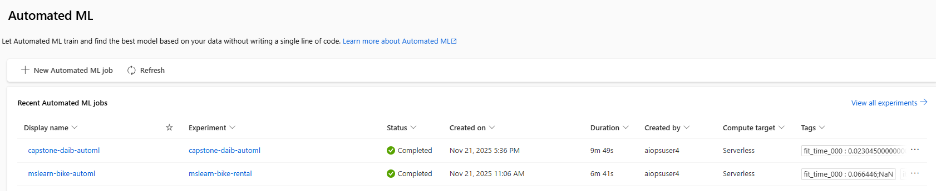
VM “capstoneskaipa” is created through Powershell

Slide 3
VM “capstoneskaipa” created through Powershell script

Slide 4
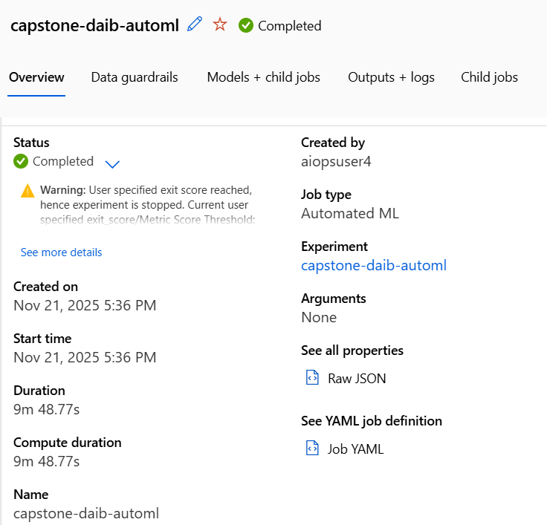
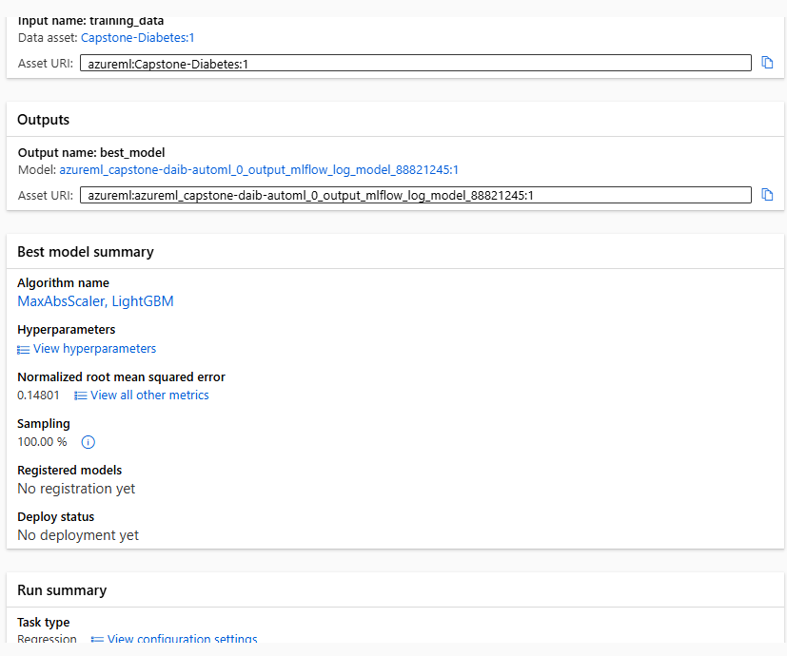
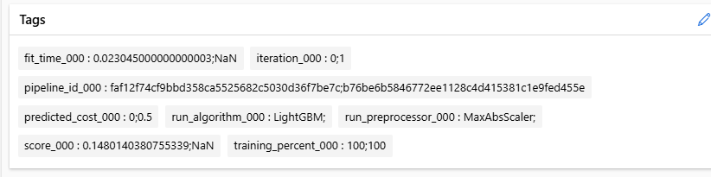
New Dataset (Diabetes) uploaded and configured successfully

Slide 5
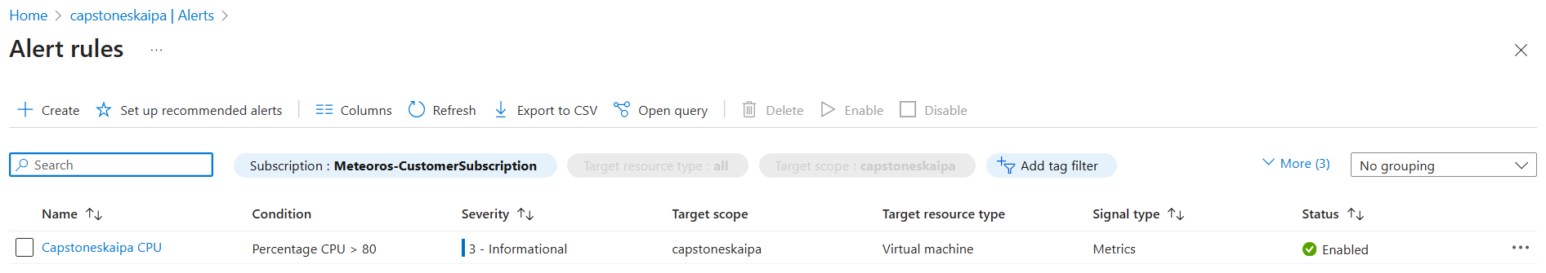
Alert rule configured successfully

Slide 6
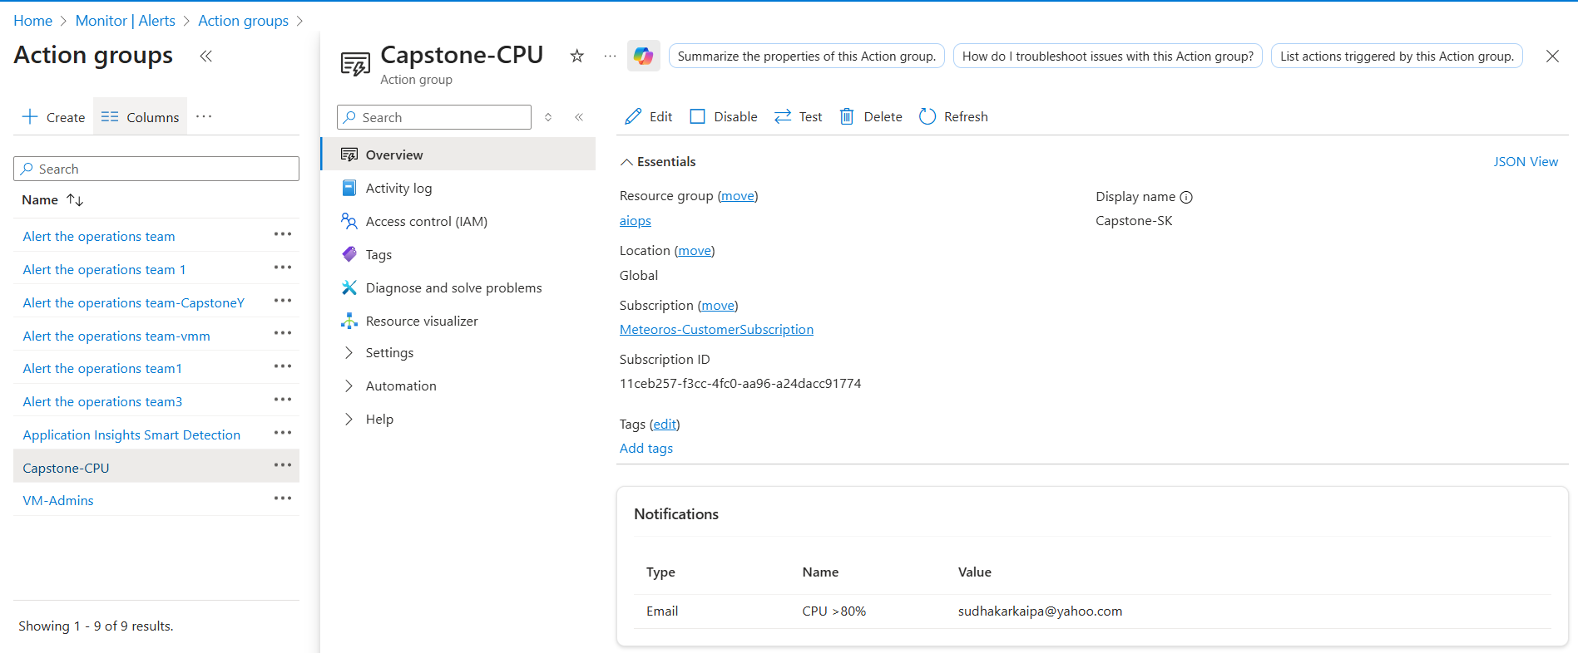
Alert group configured successfully

Slide 7
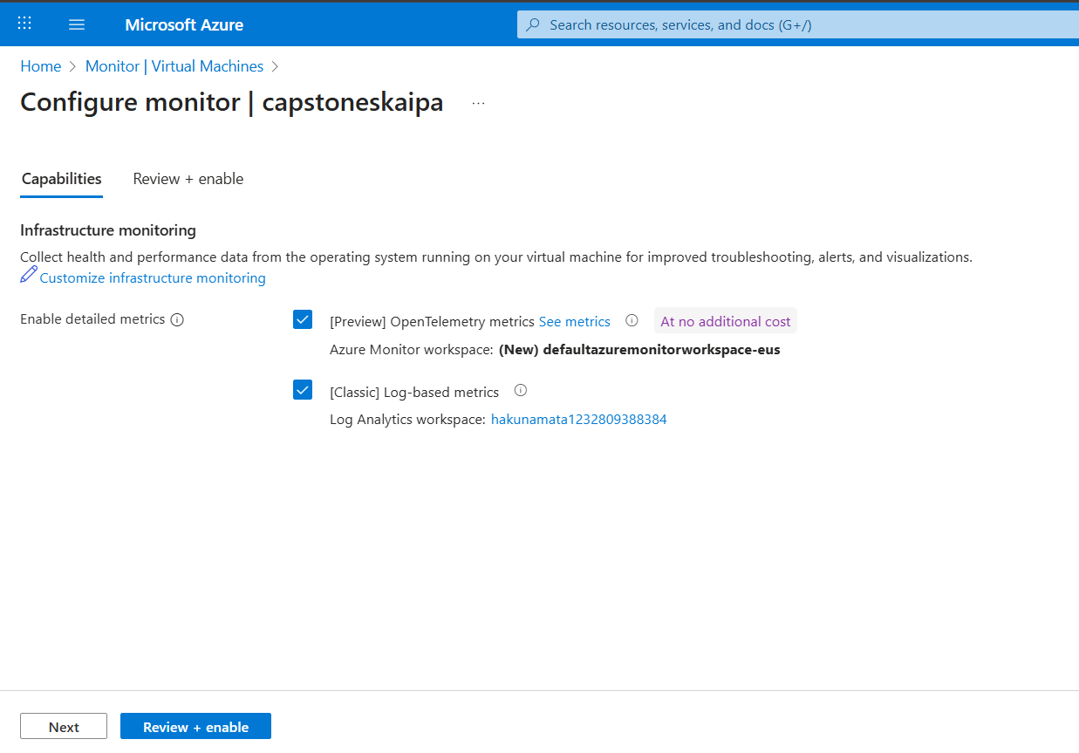
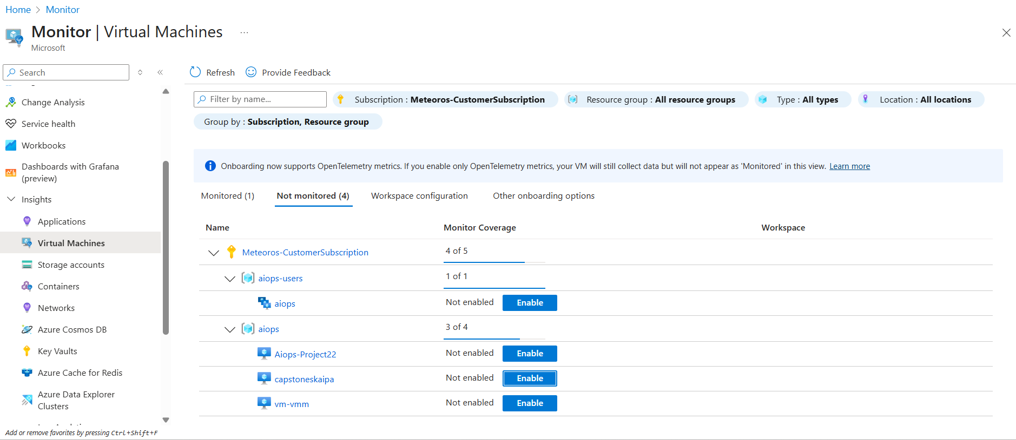
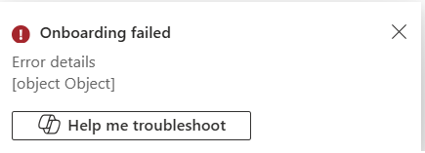
Enabling monitoring on the new VM “capstoneskaipa”
We tried multiple choices for enabling monitoring on the new VM. But it was giving the same error.

Slide 8
Challenges Faced:
Deployment of the dataset was failing, as it was during the training session.. However the files are downloaded and uploaded to Github
After Creating the VM through Powershell successfully, we were not able to enable the monitoring. (Please recall the trainer has enabled the monitoring during the training sessions due to this problem)

